Slide 1


Crowdsourced Mobile Video Analytics for Emerging Real-time Risk Management in Smart Cities
Project of Strategic Importance 20/21
Song GUO[COMP], Heng Li [BRE], Lam, Kin Man [EIE], Li Ping [COMP]

Slide 2
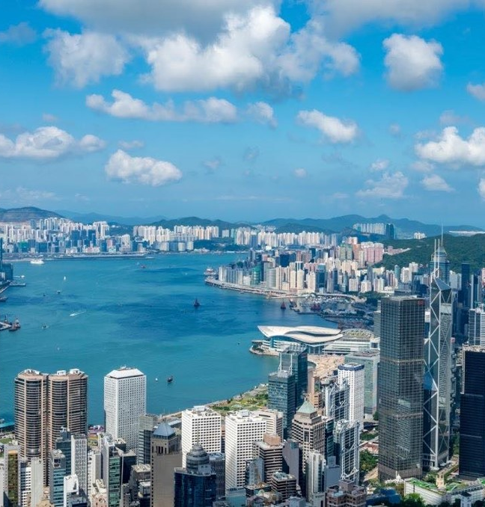
Outline
An overview of our Research
Background and Limitation
Objectives and Challenges
Methodology and Feasibility
Deliverables and Significance
Research Plan

Slide 3
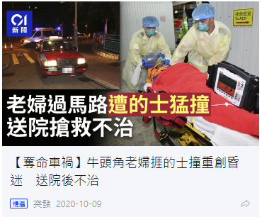
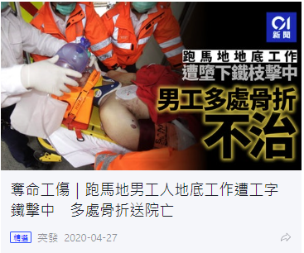
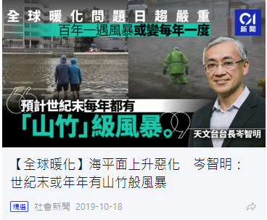
Background: City Challenges
No city is immune to disasters.
traffic accident
construction incident
Q: How to Respond to City-wide Challenges ？
hurricanes
Notes:
No city is immune to disasters. Even regions fortuitously protected from earthquakes and volcanoes could face natural disasters such as hurricanes,
and man-made disasters, such as traffic accident, construction site incident.
Traffic Accident:
Road traffic accident is one of the common disasters in the city and cause the largest number of death. According to the report of WHO, deaths from road traffic crashes have increased to 1.35 million a year. That's nearly 3,700 people dying on the world's roads every day. With a total area of 1102 km2 , Hong Kong has a population of 7.5 million and 899 517 licensed vehicles as at 01 Aug 2020. Moreover, the complex road network in hong kong also increases the risk of traffic accident. According to the data from HK transportation department, road accident cause 60000 injury and 300 deaths in recent three years.
https://www.td.gov.hk/filemanager/tc/content_4994/19keyc.pdf
https://www.dw.com/en/traffic-accidents-kill-more-than-1-million-people-who-says/a-46628952
Site Accident:
Falls
Struck by Object
Electrocution Hazards
https://www.housingauthority.gov.hk/mini-site/site-safety/en/publications/performance-statistics/index.html

Slide 4




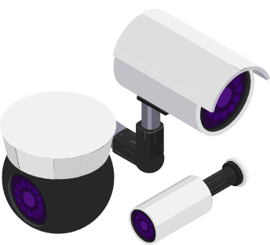






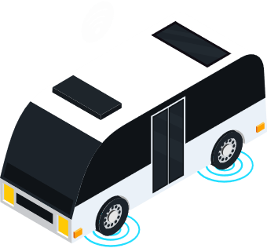



Background: Emerging Smart City
Transform Cities with Smart Technology
AI-empowered Unmanned Smart City Services
Sensing
Connection
Computing
Innovation
surveillance camera
Sensor
lampposts
Vehicle
IoT
Wireless Network
Cloud Computing
AI
Notes:
Requirements.
In the event of an emergency, pre-existing preparedness measures and the rapid execution of post-emergency plans could make the difference between life and death for those affected.
Why smart city?
The emerging smart city make the governments to quickly collect information, process it to reach an optimal response, and disseminate the decision. Sensors such as surveillance cameras, water level gauges, rain gauges and seismometers can be used to gather information on disasters and emergencies. All these data can be seamlessly integrated at a command center, and then rapidly distributed to the different agencies such as the police, army and hospitals.

Slide 5

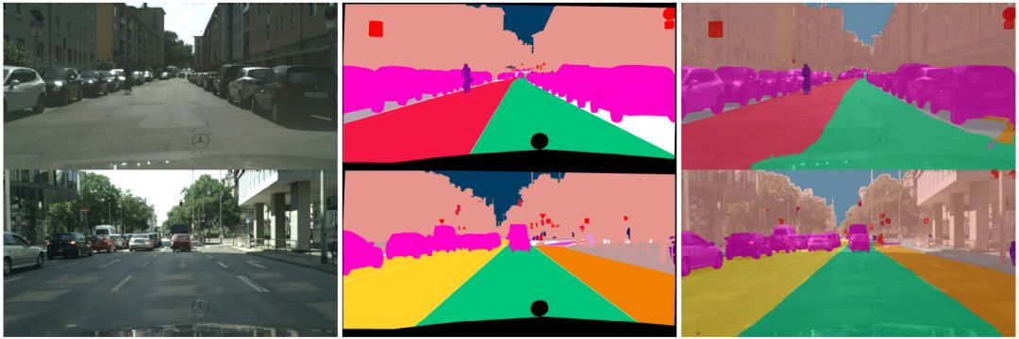
Background: Conventional Solutions
Computer vision is the most promising technology in smart city
(a) object detection on Road
(b) segmentation on road
Computer Vision Techniques in Smart City

Slide 6
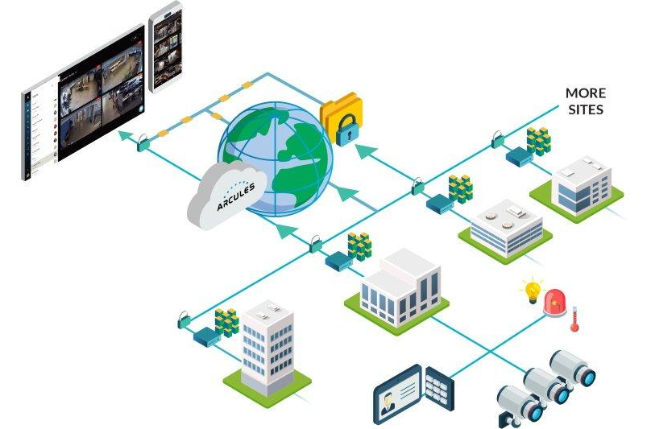
Limitations of Cloud-based Solutions
The cloud-based solutions raises serios concern on latency, privacy and cooperation
Limitation
High latency
latency caused while communicating information from the device across the network to the centralized computing system.
Data privacy
The personal data privacy concerns for data users in the use of cloud computing are largely related to the loss or lack of control over the use, retention/erasure and security of personal data entrusted to cloud providers.
Limited Views
Traditional video surveillance systems has limited view which lows the efficiency of training and inference.
Cloud-based Video System
Device -> Data -> AI on Cloud> Result-> Device
Notes:
http://www.giovannigualdi.com/?page_id=122
https://volansys.com/portfolio/cloud-based-video-media-streaming-and-monitoring-software-as-service-for-home-security-surveillance/
https://blog.hamibook.com.tw/3c%E7%A7%91%E5%AD%B8/%E5%BF%AB%E8%AE%80_%E6%95%B8%E4%BD%8D%E6%99%82%E4%BB%A3292%E6%9C%9F-2018%E5%B9%B49%E6%9C%88%E8%99%9F_%E3%80%90%E5%B0%81%E9%9D%A2%E6%95%85%E4%BA%8B%E3%80%91/?p=37911

Slide 7
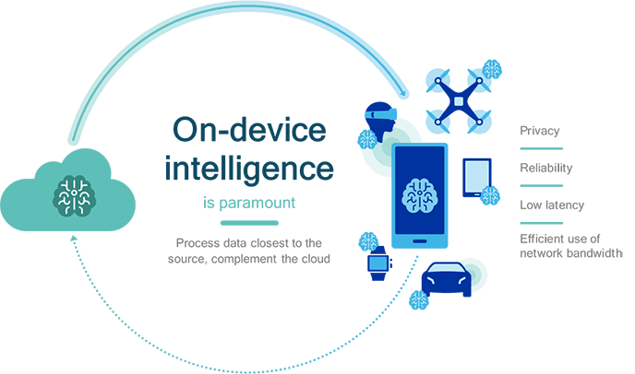
Objectives
Learning on Edge Devices is the new trend
Edge devices is the most promising platform for Risk Management in Smart City
Superior Scale
> 8.6 BILLION
Cumulative Smartphone unit shipments forecast between 2018-2022
Annual Performance Boost
> 2X
Annual Performance Improvement forecast between 2018-2022
Objectives: Real-time Big Data Analytics Platform Over Ubiquitous Edge Networks
Notes:
http://www.giovannigualdi.com/?page_id=122
https://volansys.com/portfolio/cloud-based-video-media-streaming-and-monitoring-software-as-service-for-home-security-surveillance/

Slide 8
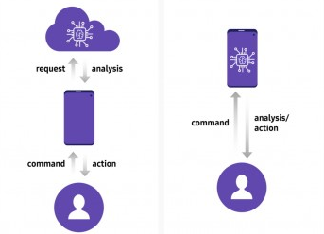
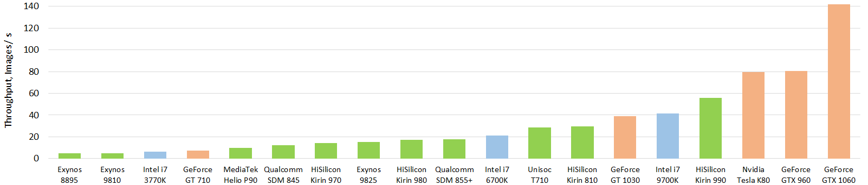
Challenge: Resource-constrained
Mobile devices has limited computation and memory resource
Mobile CPU
Desktop CPU
GPU
AI with Cloud Server
On-device AI
Communication-free
Has potential to reduce latency
Limited Computation Resource
Require Optimized AI Algorithms
Notes:
http://www.giovannigualdi.com/?page_id=122
https://volansys.com/portfolio/cloud-based-video-media-streaming-and-monitoring-software-as-service-for-home-security-surveillance/

Slide 9
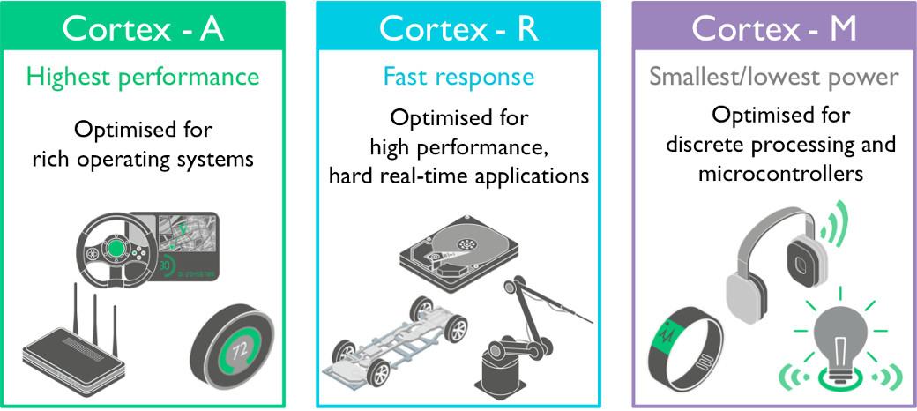
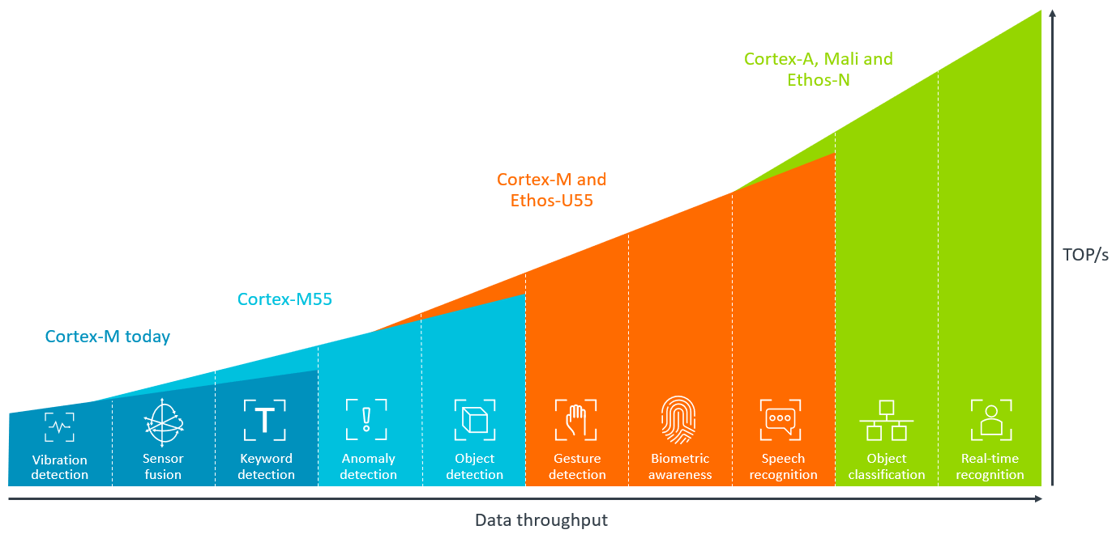
Challenge：Heterogeneous
Adaptive to Heterogeneous and Resource-constraint Mobile Devices
Heterogeneous performance of different arm CPU
Notes:
http://www.giovannigualdi.com/?page_id=122
https://volansys.com/portfolio/cloud-based-video-media-streaming-and-monitoring-software-as-service-for-home-security-surveillance/

Slide 10
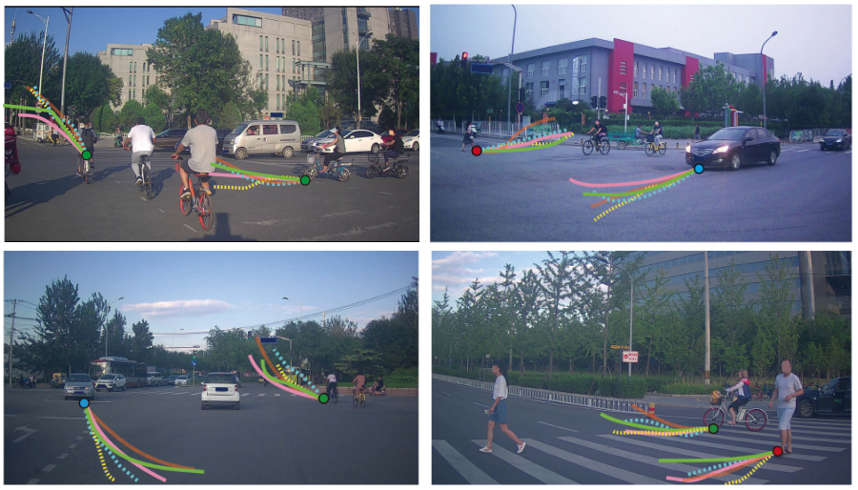
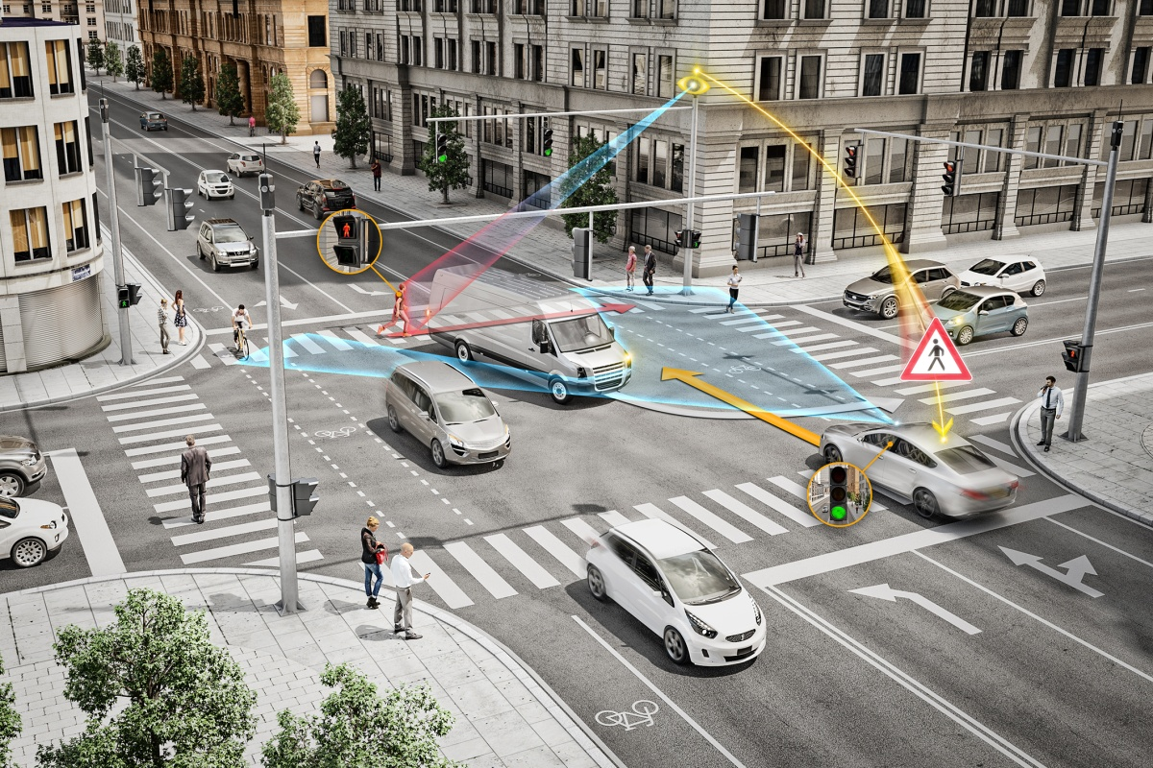
Challenge：Limited Views
Limited views of isolated camera
Trajectory prediction
Risk Detection
Notes:
http://www.giovannigualdi.com/?page_id=122
https://volansys.com/portfolio/cloud-based-video-media-streaming-and-monitoring-software-as-service-for-home-security-surveillance/

Slide 11
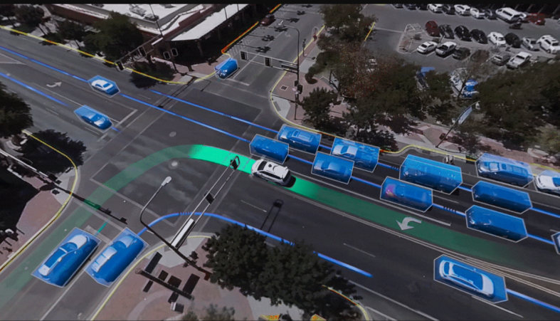
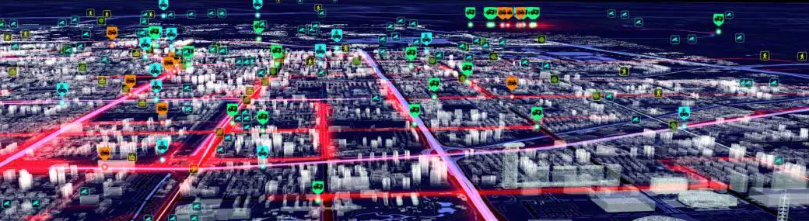
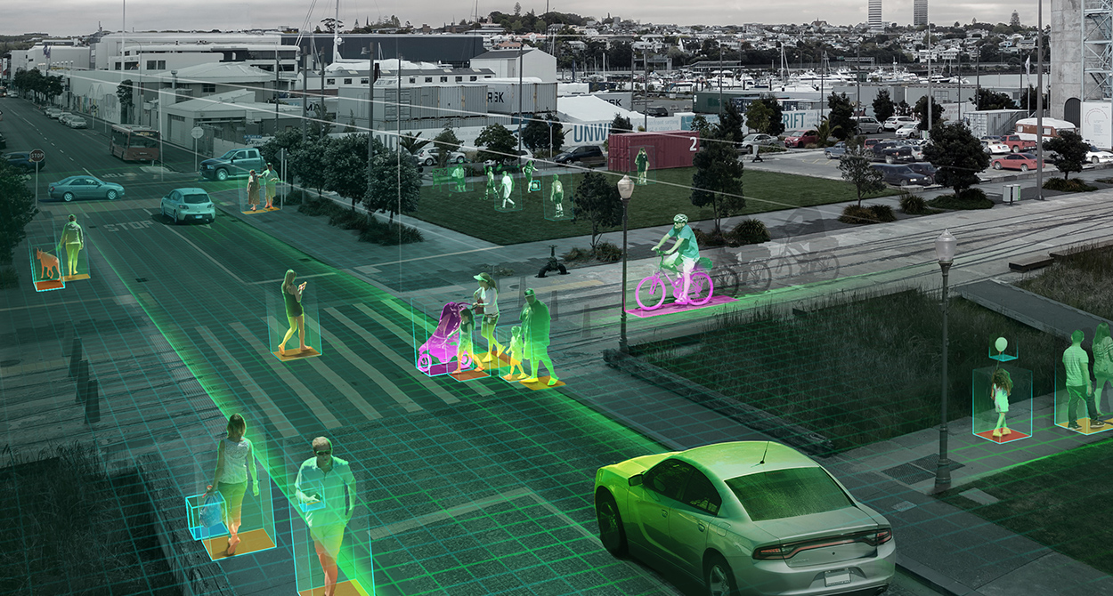
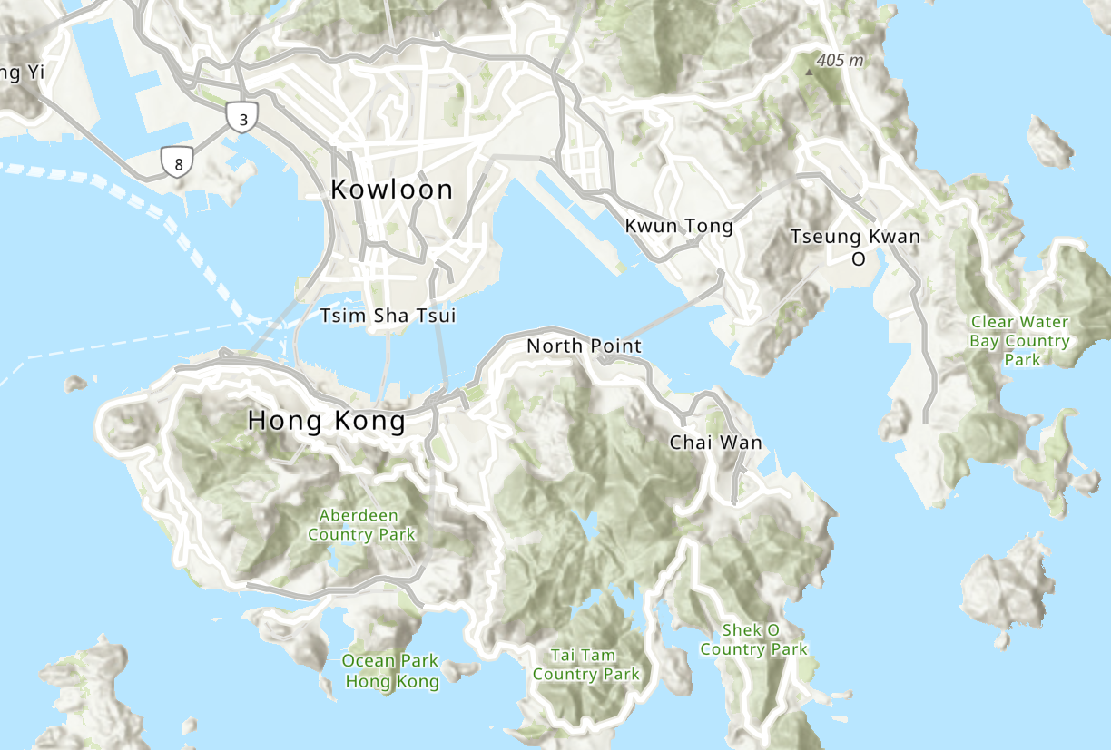



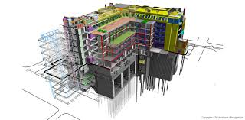
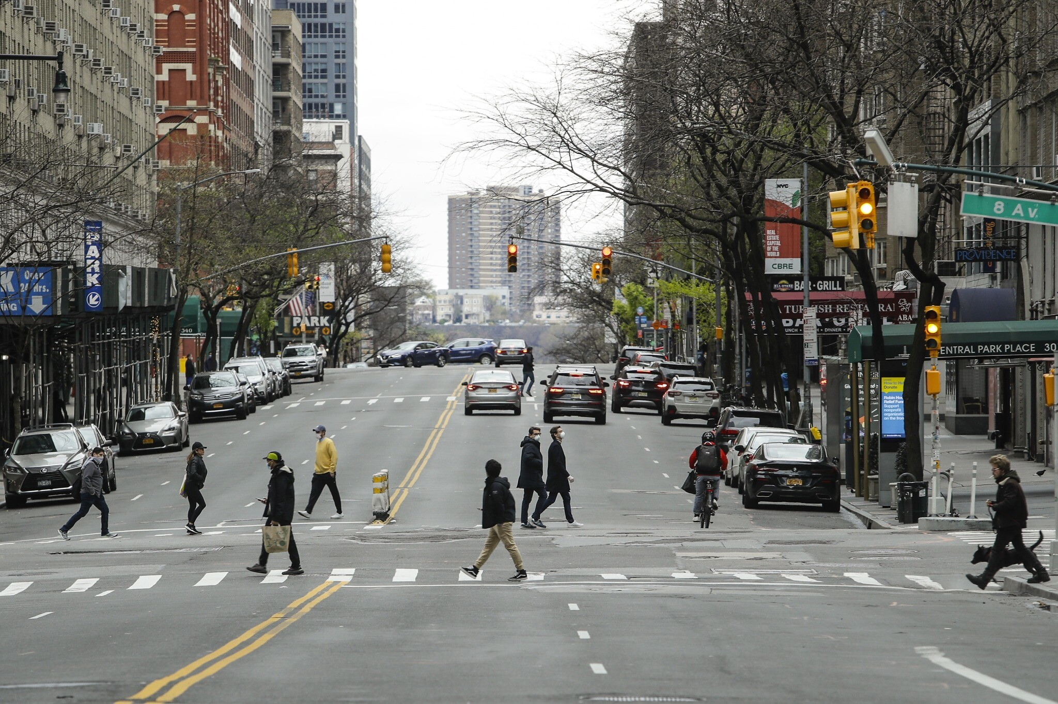

Methodology
1. Real–time Risk Management Platform
Emergency self-defending
Proactive risk prediction
Emergency event simulation
Big data analytics
Emergency response
General state of digital entity
Real-time data
Learning task distribution
1. Interactive Digital twins with crowdsourced edge devices.
2. High Performance Collaborative Learning
Split learning
spatial
data
updating
Transfer learning
Multiview aggregation
GSD
Digital Twins
Fog/Cloud Sever
control
sensing
connected
sensing
Model pruning
BIM
Knowledge distillation
Physical World
Edge devices
Notes:
Requirements.
In the event of an emergency, pre-existing preparedness measures and the rapid execution of post-emergency plans could make the difference between life and death for those affected.
Why smart city?
The emerging smart city make the governments to quickly collect information, process it to reach an optimal response, and disseminate the decision. Sensors such as surveillance cameras, water level gauges, rain gauges and seismometers can be used to gather information on disasters and emergencies. All these data can be seamlessly integrated at a command center, and then rapidly distributed to the different agencies such as the police, army and hospitals.

Slide 12


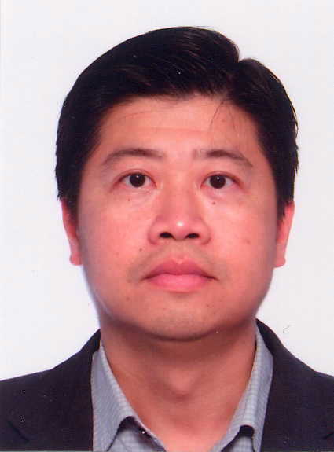
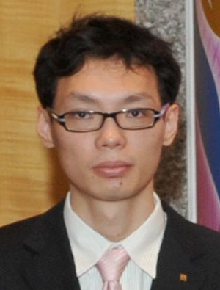
Research Teams
PI Guo, Song [COMP]
Edge learning
Co-PI Li, Heng [BRE]
Smart construction
Co-PI Kin-Man Lam [EIE]
Video analysis
Co-PI Li, Ping [COMP]
Graphics and AI
[RIF] Edge Learning: the Enabling Technology for Distributed Big Data Analytics in Cloud-Edge Environments
[ITF] Proactively Monitoring Construction Progress by Integrating 3D Laser-scanning and BIM
[GRF] Efficient Techniques for Model-Based Video Coding
[NSFC/FDCT] Key Techniques for Aided Decision-making of Urban Scene Abnormal Events Based on Cross-view Panoramic Video

Slide 13
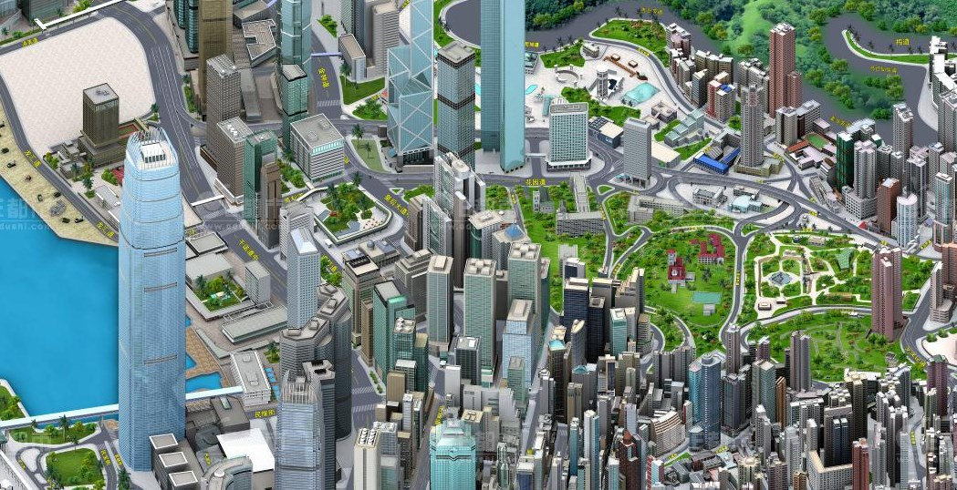
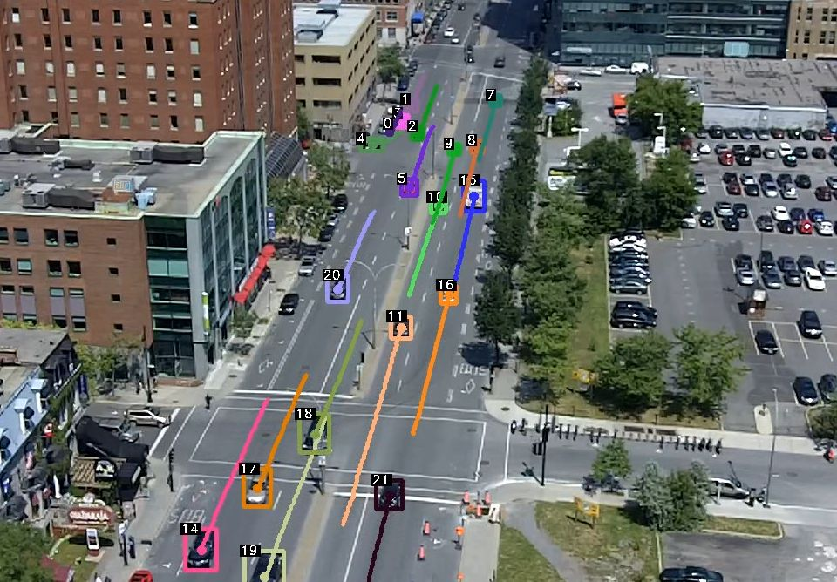

Task 1: Interactive Digital Twins for Smart City
Principal
Visualization
Entity digitization
State monitoring
Interactive interface
Task 1 principal
Interactive Digital Twins for Smart City
environment
state
control
Prof. Li, Heng has rich experience in digital construction and BIM, and he will lead the research on Digital Twins.
Prof. Kenneth K. M. Lam with his abundant experience in computer vision, will assist the development of video-based City information Sensing.
Road
Building
Infrastructure
Pedestrian
Vehicle
City Information Modeling
control interface
geographical data
building data
sensing data
control parameters
GSD
BIM
Mobile & IoT
Public utility
Multi-source City Information
Controllable Utility
Notes:
Requirements.
In the event of an emergency, pre-existing preparedness measures and the rapid execution of post-emergency plans could make the difference between life and death for those affected.
Why smart city?
The emerging smart city make the governments to quickly collect information, process it to reach an optimal response, and disseminate the decision. Sensors such as surveillance cameras, water level gauges, rain gauges and seismometers can be used to gather information on disasters and emergencies. All these data can be seamlessly integrated at a command center, and then rapidly distributed to the different agencies such as the police, army and hospitals.

Slide 14


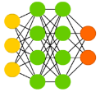
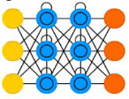

Task 2: High Performance Collaborative Learning
Principal
Task 2 principal
high
high
Split Learning
Hybrid intelligent computing
Transfer Learning
Multi-view aggregation
Cloud Computing on Data Center
Collaborative Learning
Control，
Update
Data,
Pattern
computation
latency
Prof. Guo, Song has been active in the fields of edge computing，big data，and he will lead the research on Collaborative learning.
Prof. Kenneth K. M. will assist the development of video-based City information Sensing.
Mobile devices
Fog Computing on Base Station
IoT devices
pruning
knowledge distillation
low
low
dashcam
mobile
vehicle-mounted device
multifunctional
lamp
traffic
camera
drone
Customized Learning
Edge Computing on device
Notes:
Requirements.
In the event of an emergency, pre-existing preparedness measures and the rapid execution of post-emergency plans could make the difference between life and death for those affected.
Why smart city?
The emerging smart city make the governments to quickly collect information, process it to reach an optimal response, and disseminate the decision. Sensors such as surveillance cameras, water level gauges, rain gauges and seismometers can be used to gather information on disasters and emergencies. All these data can be seamlessly integrated at a command center, and then rapidly distributed to the different agencies such as the police, army and hospitals.

Slide 15
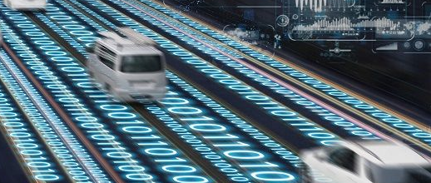
Task 3: Real –time Risk Management Platform
Real–time Risk Management Platform
Task 3 principal
Proactive risk prediction
Emergency event simulation
Multi-agent decision
pedestrian trajectory prediction
Reinforcement learning
vehicle trajectory prediction
Emergency self-defending
Real-time data analytics
Infrastructures adaption
time series data
Prof. Guo, Song will lead the development of real-time risk management platform based on digital twins.
Dr. Li, Ping, will assist on Al algorithms for Effective Risk Detection
Emergency route planning
spatial data
Emergency
response
state of
digital entity
Real-time
data
task
distribution
Interactive Digital Twin
High Performance Collaborative Learning
Notes:
Requirements.
In the event of an emergency, pre-existing preparedness measures and the rapid execution of post-emergency plans could make the difference between life and death for those affected.
Why smart city?
The emerging smart city make the governments to quickly collect information, process it to reach an optimal response, and disseminate the decision. Sensors such as surveillance cameras, water level gauges, rain gauges and seismometers can be used to gather information on disasters and emergencies. All these data can be seamlessly integrated at a command center, and then rapidly distributed to the different agencies such as the police, army and hospitals.

Slide 16
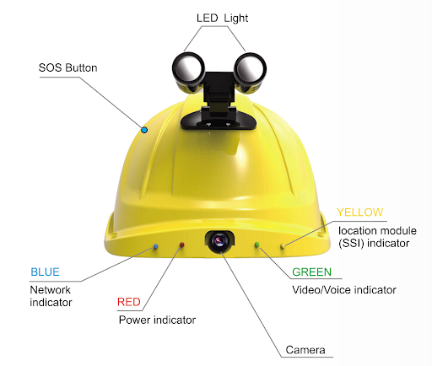
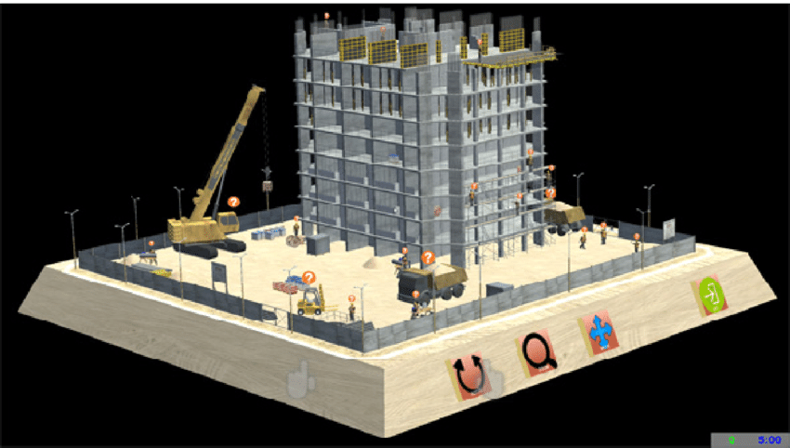
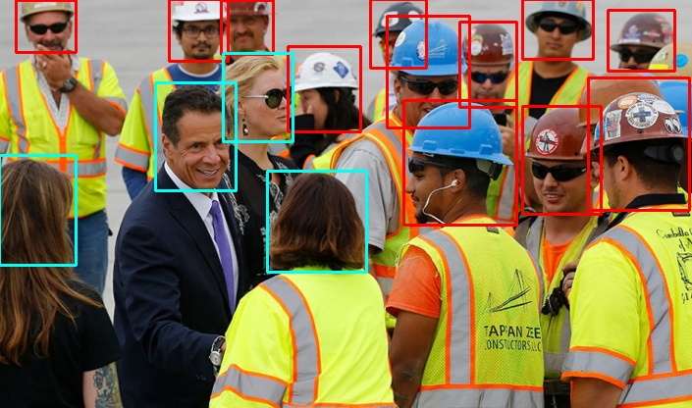
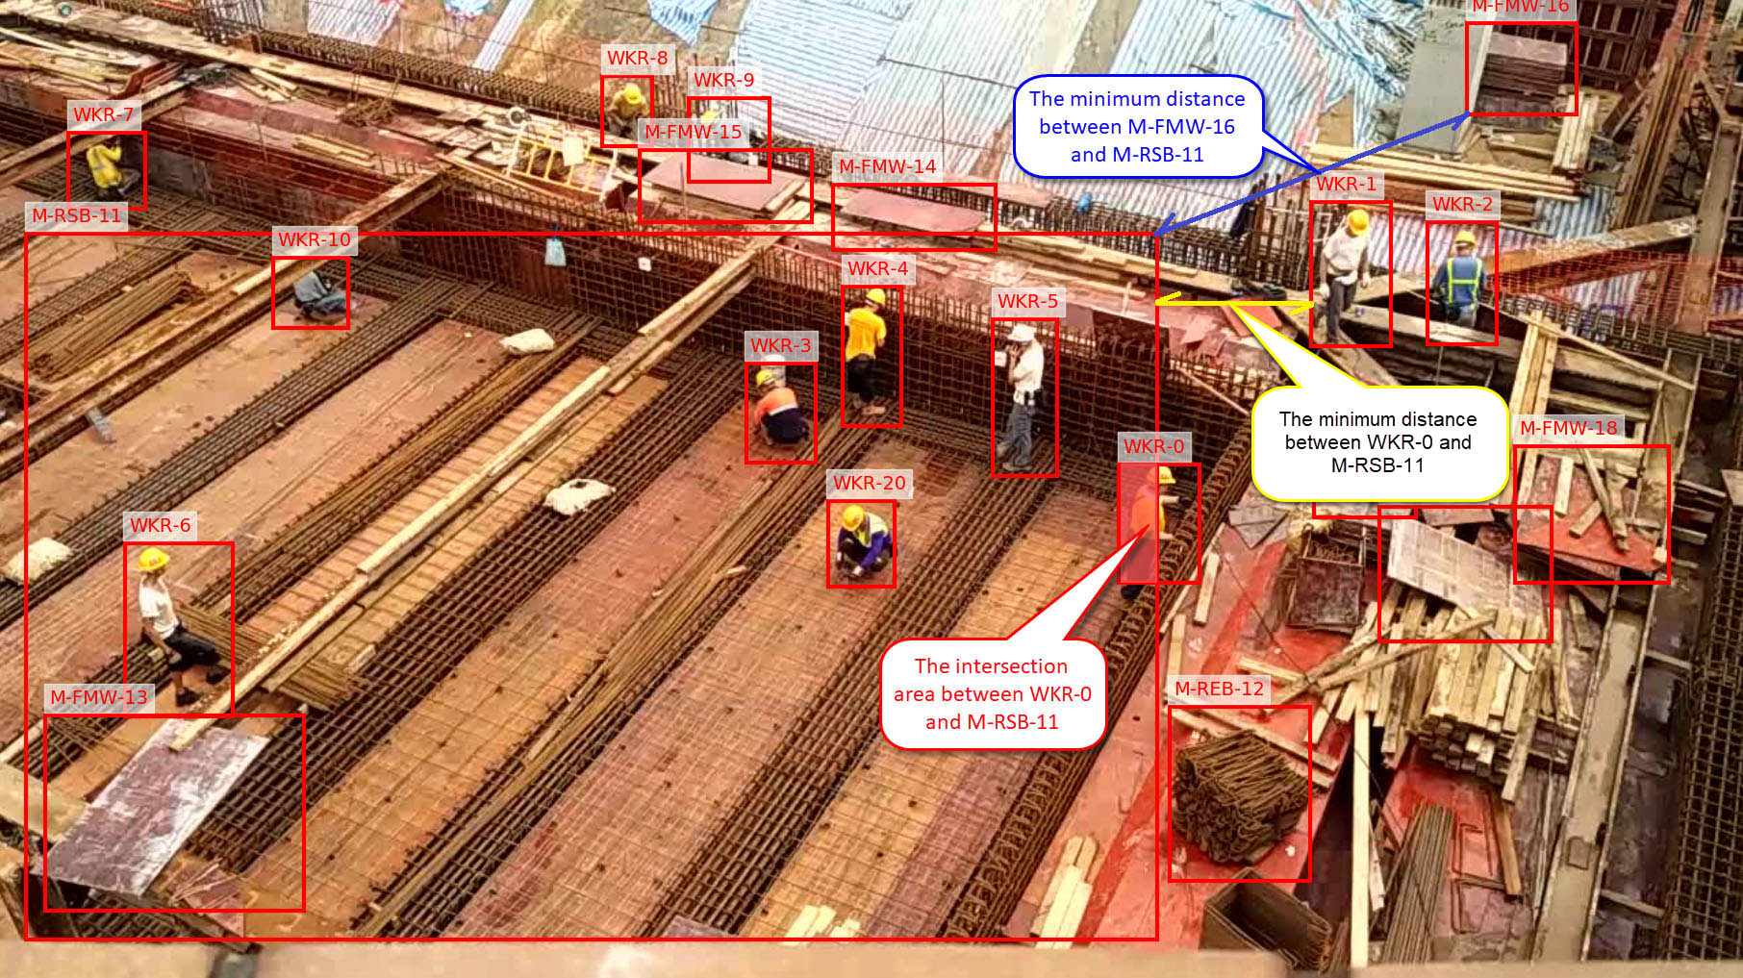
Demo : Risk management on construction site
Edge Computing Platform
hardware
Fall Prediction
notice
Helmet Detection
Hook Approaching
emergency
response
digital
state
Smart Helmet View
Security Camera View
data
Digital Construction Cite
Worker & Cite sensing
All the team member will work on a demonstration applications on a real-time risk management platforms for smart construction. Prof. Li, Heng has done prior research in digital and smart
construction. The research teams will extend the previous project with real-time video analytics for better protecting the safety of the worker.

Slide 17
Deliverables
Software
Demo
Grant
An open-source software library for enabling collaborative on-device video analytics
A smart Construction demo for protecting the lives of workers
Major project proposal based on edge AI for smart city
2021 END
2022 MID
2022 END

Slide 18
Significance
Risk Management in Smart Cities is a significant research field that can save lives and loss caused by city disasters
Critical Problem
Real-time Video Data Analytics Platform Over Cooperative Ubiquitous Mobile Networks
Novel Approach
Research Impact
This project meets the AI and Smart city strategic of Hong Kong.
Promote the innovation application in smart cities.
Raise the city's capabilities of handling with emergency risks

Slide 19
Project Duration and Budget
Project Duration
2 Years
Year 1 – digital twins and cooperative learning techniques
Year 2 –risk detection and management and demo implementation
Project Budget
HK$ 2,000,000
Department of Computing– HK$ 1,000,000
Hong Kong Polytechnic University– HK$ 1,000,000

Slide 20




Thank You
Song Guo
(852) 2766 7259
cssongguo@comp.polyu.edu.hk
PQ818

